Slide 1
MODULE 5

Slide 2
Attack-Resistant Recommender Systems
The input to recommender systems is typically provided through open platforms.
The effectiveness of a recommender system depends almost exclusively on the quality of the data available to it.
Unfortunately, there are significant motivations for participants to submit incorrect feedback about items for personal gain or for malicious reasons:
The manufacturer of an item or the author of a book might submit fake (positive) reviews on Amazon in order to maximize sales. Such attacks are also referred to as product push attacks.
The competitor of an item manufacturer might submit malicious reviews about the item. Such attacks are also referred to as nuke attacks.

Slide 3
The person making the attack on the recommender system is also referred to as the adversary.
By creating a concerted set of fake feedbacks from many different users, it is possible to change the predictions of the recommender system.
Such users become shills in the attack process. Therefore, such attacks are also referred to as shilling attacks.
An adversary would need to create a large number of fake users (or fake profiles) to achieve the desired outcome.
A profile refers to a set of ratings corresponding to a fake user created by the adversary.

Slide 4
The number of injected profiles may depend on the specific recommendation algorithm being attacked, and the specific approach used to attack it.
An attack that requires a smaller number of injected profiles is referred to as an efficient attack because such attacks are often difficult to detect.
If an attack requires a large number of injected profiles, then such an attack is inefficient attack .
The effectiveness of the attacks may depend on the specific recommendation algorithm being used.
Some recommendation algorithms are more robust to attacks than others

Slide 5
Attacks can also be classified based on the amount of knowledge required to mount them successfully.
low-knowledge attacks
high knowledge attacks
Some attacks require only limited knowledge about the ratings distribution. Such attacks are referred to as low-knowledge attacks.
Attacks that require a large amount of knowledge about the ratings distribution are referred to as high knowledge attacks.
If adversaries have more knowledge about the ratings distribution, then they can generally make more efficient attacks.

Slide 6
Understanding the Trade-Offs in Attack Models
Example 1- Naïve attack
5 items and 6 (real) users.
The ratings are all drawn from the range of 1 to 7, where 1 indicates extreme dislike and 7 indicates extreme like.
Furthermore, an attacker has injected 5 fake profiles, which are denoted with the labels Fake-1, Fake-2, Fake-3, Fake-4, and Fake-5.
The goal of this attacker is to inflate the ratings of item 3.

Slide 7
Therefore, this attacker has chosen a rather naive attack, in which they have inserted fake profiles containing a single item corresponding to the item 3.
However, such an attack is not particularly efficient. It is highly detectable because only a single item is included in every injected profile with a very similar rating.
Furthermore, such ratings injections are unlikely to have a large impact on most recommendation algorithms.
Consider, a user-based neighborhood algorithm in which the profiles are used to make predictions for Mary.
None of the injected profiles will be close to the rating profile of Mary; therefore, Mary’s predicted ratings of item 3 will not be affected by the injection of the fake profiles.

Slide 8
Example 2
Here the attacker is trying to promote item 3, but he or she also adds random ratings to other items in order to reduce the detectability.
Consider the case where a user-based neighborhood is used to perform the recommendation.
When only genuine profiles are used, John and Sayani are among Mary’s neighbors and item 3 will have a low predicted rating for Mary.
When fake profiles are also injected before user-based recommendation, most of the fake profiles are not close to Mary because the ratings are randomly chosen.

Slide 9
However, the to be close to Mary by chance.
As a result, the predicted rating of Mary for item 3 will increase.
Therefore, from the point of view of an adversary, this type of attack does a better job than a completely naive attack with a single item.
But this attack is quite inefficient because a large number of injected profiles would be required to affect the results of a neighborhood-based algorithm.
In general, it is hard to ensure that randomly injected ratings will be close enough to a particular target user to whom the recommendation is to be made.
After all, it is important for fake profiles to be close to target users in order to significantly affect the recommendation in any way.

Slide 10
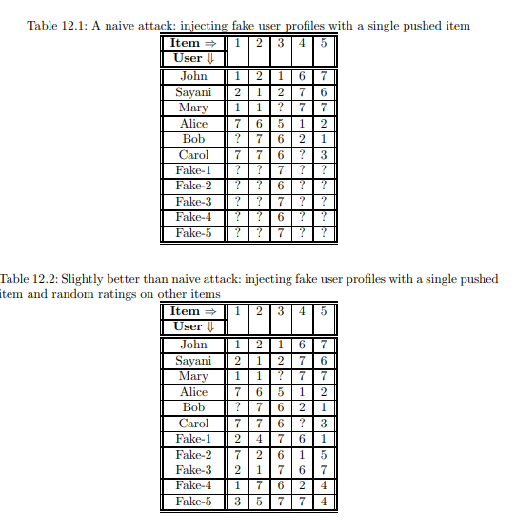

Slide 11
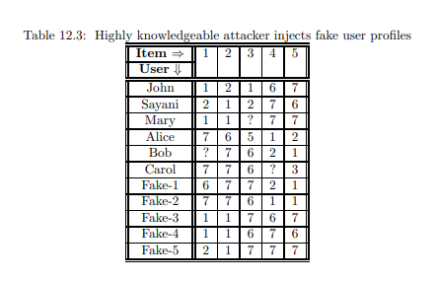

Slide 12
Observations made
Carefully designed attacks are able to affect the predictions with a small number of fake profile insertions. On the other hand, a carelessly injected attack may have no effect on the predicted ratings at all.
When more knowledge about the statistics of the ratings database is available, an attacker is able to make more efficient attacks. However, it is often difficult to obtain a significant amount of knowledge about the ratings database.
The effectiveness of an attack algorithm depends on the specific algorithm being attacked

Slide 13
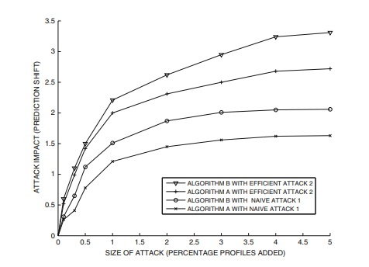

Slide 14
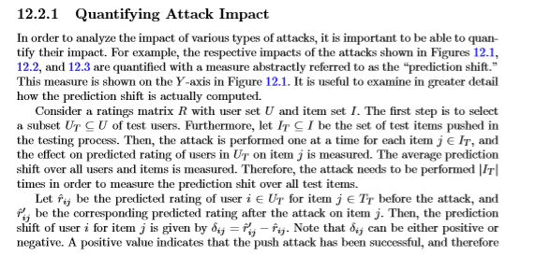

Slide 15
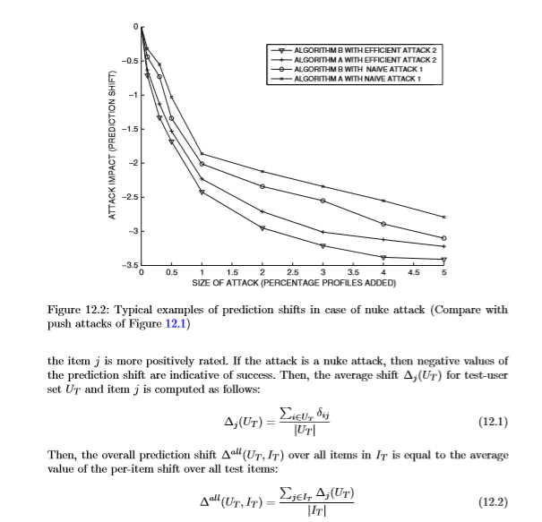

Slide 16
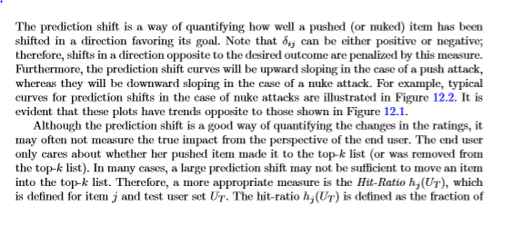

Slide 17
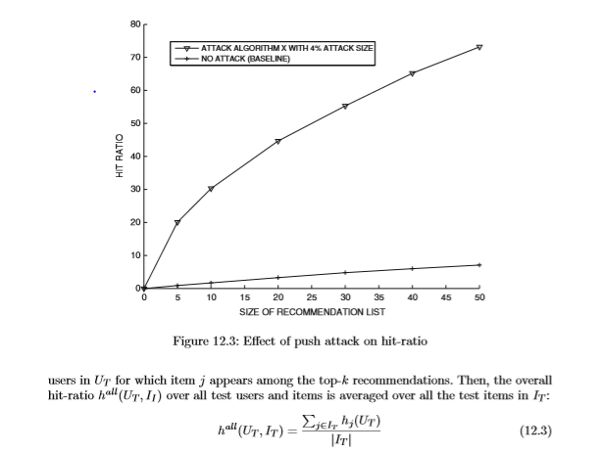

Slide 18
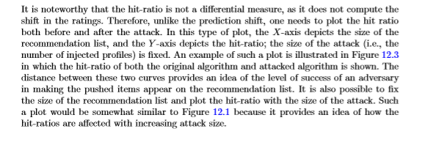

Slide 19
Types of Attacks
Although the rating of a particular item may be targeted in an attack, it is important to inject ratings of other items in order to make the attack eﬀective.
If fake proﬁles of only a single (pushed or nuked) item are inserted, they generally do not signiﬁcantly aﬀect the outcome of many recommendation algorithms.
Furthermore, such attacks are generally easy to detect using automated methods. Therefore, the ratings of additional items are included in the injected proﬁle. Such items are referred to as ﬁller items.

Slide 20
1)Random Attack
In the random attack, the ﬁller items are assigned their ratings from a probability distribution that is distributed around the global mean of all ratings across all items.
Because the global mean is used, the ratings of the various ﬁller items are drawn from the same probability distribution.
ie, A random attack is a way to manipulate a recommendation system by adding fake user profiles that include random ratings for various items.
The goal is to change the rating of a specific item (called the target item) to make it look better or worse than it actually is.

Slide 21
How Does a Random Attack Work?
Choose a Target Item: Decide which item you want to manipulate. For example, you might want to make a specific movie appear more popular (push attack) or less popular (nuke attack).
Set the Target Item's Rating: For a push attack, you give the target item the highest possible rating. For a nuke attack, you give it the lowest possible rating.
Select Filler Items: Randomly pick other items from the database to include in the fake profiles. These items are called filler items.
Assign Ratings to Filler Items: Give these filler items ratings that are distributed around the average rating of all items in the system. This makes the fake profiles look like they're giving average ratings to random items, just like real users might.

Slide 22
2)Average Attack
The average attack is similar to the random attack in terms of how the ﬁller items are selected for rating.
The same set of ﬁller items are selected for each proﬁle.
However, the average attack diﬀers from the random attack in terms of how the ratings are assigned to the selected items.
In the average attack, the ratings that are assigned to the ﬁller items have values that are speciﬁed at or approximately at the average of the speciﬁc item. The target item is assigned either the maximum rating or the minimum rating depending on whether the attack is a push attack or a nuke attack.
Note that the average attack requires a greater amount of knowledge than the random attack, because knowing the global mean is not suﬃcient.
One also needs to know the mean of each ﬁller item. Furthermore, the attack is somewhat conspicuous because the same set of ﬁller items is used for each fake proﬁle.
In order to reduce the possibility of detection, one can also use randomly selected ﬁller items for each injected user proﬁle. The drawback of doing this is that a greater amount of knowledge will be required for making the attack.

Slide 23
Bandwagon attack
The basic idea of the bandwagon attack is to leverage the fact that a small number of items are very popular in terms of the number of ratings they receive.
For example, a blockbuster movie or a widely used textbook might receive many ratings. Therefore, if these items are always rated in the fake user proﬁle, it increases the chance of a fake user proﬁle being similar to the target user.
In such cases, the predicted ratings of the target user are more likely to be aﬀected by the attack. Therefore, the knowledge about the popularity of the items is used to improve the eﬃciency of the attack. In addition to the popular items, a set of random items is used as additional ﬁller items.

Slide 24
How Does a Bandwagon Attack Work?
Choose a Target Item: Identify the item you want to manipulate (e.g., make it appear more or less popular).
Set the Target Item's Rating:
For a push attack (to promote the item), assign the highest possible rating to the target item.
For a nuke attack (to demote the item), assign the lowest possible rating to the target item.
Select Popular Items: Identify a set of very popular items that receive many ratings and are widely liked. These items will be rated in every fake profile.
Assign Ratings to Popular Items: Give these popular items the highest possible rating. This increases the similarity between the fake profiles and many real user profiles, as popular items are often rated highly by many users.
Add Random Filler Items: Choose additional random items as filler items and assign them random ratings. This helps to make the fake profiles look more natural and less suspicious.
.

Slide 25
Popular Attack
The popular attack shares a number of similarities with the bandwagon attack in that it also uses popular items in order to create the ﬁller items.
However, the popular items might be either widely liked or widely disliked items, but they must have many ratings.
The popular attack also assumes more knowledge about the ratings database to set the ratings of these popular items. Therefore, More popular items have to be used in this attack than in the case of the bandwagon attack.
In order to achieve a push attack, the ratings of the various ﬁller items in a fake user proﬁle are set as follows:
If the average rating of a ﬁller item in the ratings matrix is less than the global rating average over all items, then the rating of that item is set to its minimum possible value rmin.
If the rating of a ﬁller item is greater than the overall average rating of all items, then the rating of the item is set to rmin + 1.
The rating of the target item is always set to rmax in the fake user proﬁle.

Slide 26
The reason for setting the ratings in this unusual way is
(a) to increase the likelihood of ﬁnding a proﬁle similar to that of the target user within the fake proﬁles by choosing diﬀerential ratings of rmin and rmin +1 for ﬁller items; and
(b) to increase the ratings gap between the target item and the ﬁller items to push the item more eﬀectively.
This attack can also be used for the case of a nuke attack with minor modiﬁcations.
In a nuke attack, the ratings of ﬁller items are set to rmax −1 for low-rated popular items, rmax for highly rated popular items, and rmin for the target item.

Slide 27
Love/Hate Attack
The love/hate attack is speciﬁcally designed to be a nuke attack, and its main advantage is that it requires very little knowledge to mount this attack.
In the love/hate attack, the nuked item is set to the minimum rating value rmin, whereas the other items are set to the maximum rating value rmax.
In spite of the minimal knowledge requirements, this attack is very eﬀective.
Nuke attacks are generally easier to mount than push attacks. Therefore, such low-knowledge attacks often have a better chance of being successful in the case of nuke attacks as compared to push attacks.
For example, a symmetrically designed attack in which the ratings of the ﬁller items are set to rmin and the rating of the target item is set to rmax, is not quite as successful for pushing items.
The love/hate attack is highly speciﬁc to user-based collaborative ﬁltering algorithms, and it is almost completely ineﬀective with item-based collaborative ﬁltering algorithms.

Slide 28
Reverse Bandwagon Attack
This attack is speciﬁcally designed to nuke items.
The reverse bandwagon attack is a variation of the bandwagon attack, in which widely disliked items are used as ﬁller items to mount the attack.
The fact that such items are “widely disliked” means that they have received many ratings.
For example, if a movie is highly promoted before its release but then turns out to be a box-oﬃce failure, then it will receive many low ratings.
These items are selected as ﬁller items. Such ﬁller items are assigned low ratings together with the nuked item.
As in the case of the bandwagon attack, it is often not very diﬃcult to discover such items from other channels.
This attack works very well as a nuke attack when an item-based collaborative ﬁltering algorithm is used for recommendation.

Slide 29
Probe Attack
An important aspect of many of the aforementioned methods is that the ratings are often artiﬁcially set to values, such as rmin and rmin +1, in an identical way across many proﬁles.
The use of such ratings tends to make the attack rather conspicuous, and therefore easily detectable.
The probe attack tries to obtain more realistic ratings for items directly from a user-based recommender system in order to use these values in the attack.
In other words, the operation of a recommender system is probed to mount the attack.
In the probe attack, a seed proﬁle is created by the attacker, and the predictions generated by the recommender system are used to learn related items and their ratings.
Since these recommendations have been generated by user-neighbors of this seed proﬁle, they are highly likely to be correlated with the seed proﬁle.
One can also use this approach to learn the ratings of items within a speciﬁc genre.
For example, in a movie recommendation scenario, consider the case where the target item to be pushed or nuked corresponds to action movies.
The seed proﬁle might contain the ratings of a set of popular action movies.

Slide 30
The seed proﬁle can then be extended further by observing the operation of a user-based collaborative ﬁltering algorithm when the seed proﬁle is used as the target user.
The recommended items and their predicted ratings can be used to augment the seed proﬁle in a realistic way.
The rating of the target item is set to rmax or rmin, depending on whether it is pushed or nuked, respectively.
The ratings of other ﬁller items learned from the probing approach are set to the average values predicted by the recommender system.

Slide 31
Segment Attack
Almost all the aforementioned attack methods work eﬀectively with user-based collaborative ﬁltering algorithms, but they do not work quite as eﬀectively with item-based algorithms.
The only exception is the reverse bandwagon attack, which is designed only to nuke items, but not to push items.
It is generally harder to attack item-based collaborative ﬁltering algorithms. One of the reasons for this phenomenon is that an item-based algorithm leverages the target user’s own ratings in order to make attacks.
The target user is always an authentic user. Obviously, one cannot use fake proﬁle injection to manipulate a genuine user’s speciﬁed ratings.
However, it is possible to change the peer items with the use of fake proﬁles.
Changing the peer items has an eﬀect on the quality of the predicted ratings.
In the segment attack, the attacker uses their domain knowledge to identify a targeted set of users (i.e., users with speciﬁc interests) to which they push the item.

Slide 32
For example, the attacker might decide to push a historical movie, such as Gladiator, to users who have liked historical movies in the past.
Note that the relevant genre for a particular movie is often common knowledge, and it does not require any speciﬁc information from the ratings matrix. T
herefore, the ﬁrst step for the attacker is to determine which segment (i.e., category or genre) of items are the closest to a given item.
Such items are assigned the maximum possible rating together with the pushed item.
An additional set of sampled ﬁller items are assigned the minimum rating.
This maximizes the variations in the item similarities towards items of the same genre.
The basic idea is for the attacker to make sure that only very similar items are used in the item-based recommendation process.

Slide 33
How Does a Segment Attack Work?
Identify the Target Item: Select the item you want to promote.
Determine the Relevant Segment: Identify the category or genre of items that are most similar to the target item. For instance, if the target item is a historical movie like "Gladiator," identify other historical movies.
Assign Ratings to the Segment:
Set the ratings of items within the same segment as the target item to the maximum possible value (rmax).
Select a set of unrelated items (filler items) and assign them the minimum rating value (rmin).

Slide 34
Advantages:
Effective for item-based collaborative filtering algorithms.
Leverages common knowledge about item genres or categories, requiring less specific data about individual ratings.
Can be used for push attacks with a higher success rate.
Limitations:
Requires some domain knowledge to identify the relevant segment.
Less effective for nuke attacks compared to push attacks.
Might still be detectable if the pattern of maximum and minimum ratings is too obvious.

